Slide 1
“Move to Improve: Discipline & Freedom Workshop”
Keith McHugh
Notes:
Workshop Opening: “Choose Your Hard”
[Start with silence and presence – look around the room, let the energy settle.]
“Let me get something out of the way right now… Nothing I’m going to talk about today is easy. Discipline isn’t easy. Waking up early, showing up when you’re tired, sticking to a routine when nobody’s watching—that stuff is hard.”
[Pause – then lower your voice, lean in a bit]
“But you know what else is hard? Feeling sick all the time. Being overweight and tired. Hating what you see in the mirror. Living life knowing you’re capable of more—but never doing anything about it. That’s hard too.”
[Beat – then let the message land]
“So we all have to choose our hard. One hard leads to strength, freedom, and pride. The other leads to regret, pain, and limitation. You get to choose. Every single day.”
[Now step into your mission – shift from pain to purpose]
“This workshop isn’t about chasing motivation. Motivation is weak—it fades. This is about building discipline. Because discipline creates freedom. And movement is medicine—for your body, your mind, and your life.”
[Final setup before the content begins]
“I’m here to challenge you, but also to give you tools. Tools that work when you don’t feel like it. Tools that help you push through. Tools that will keep you moving long after the motivation fades.”

Slide 2

“Discipline equals freedom.”
-Jocko Willink
Notes:
Discipline as a Tool for Goal Achievement:
When individuals practice self-discipline, they are better equipped to manage their time, energy, and resources effectively. This, in turn, enables them to work towards their objectives with greater focus and efficiency. For instance, financial discipline can lead to financial freedom, and time management discipline can lead to more free time.
Examples:
Financial Discipline: Saving money, budgeting, and avoiding unnecessary spending can lead to financial independence and freedom from financial worries.
Time Management Discipline: Prioritizing tasks, sticking to schedules, and saying "no" to distractions can create more free time for personal interests and activities.
Health Discipline: Adhering to a healthy diet, exercising regularly, and practicing good sleep hygiene can lead to better physical health and freedom from chronic illnesses.
Mental Discipline: Practicing mindfulness, overcoming negative thought patterns, and cultivating positive habits can lead to greater mental well-being and freedom from anxiety and stress.

Slide 3
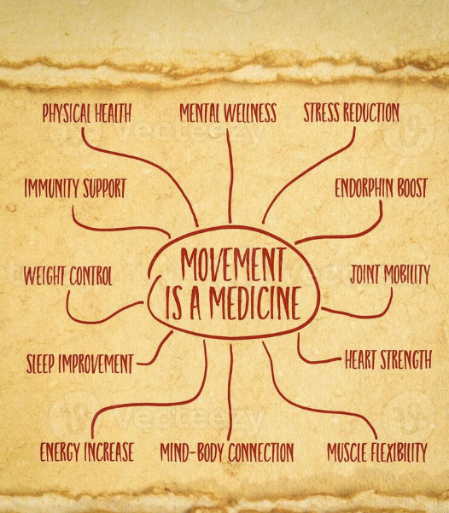
“Movement is medicine for creating change in a person’s physical, emotional, and mental states.”
— Carol Welch
Movement is Medicine
Notes:
Talking Points:
Movement creates physical, emotional, and mental change.
Stagnation leads to decay; movement promotes growth and healing.
Energy follows action.
Even when you’re tired or stressed, purposeful movement boosts energy and mood.
Mind and body are linked.
Movement breaks mental patterns and helps shift your mindset.
Simple or complex—it all counts.
From walking to martial arts, any daily movement improves long-term health.
Movement aids recovery.
Gentle, intentional movement can reduce illness duration and accelerate healing.
Move with purpose, every day.
It’s a lifelong prescription for strength, clarity, and resilience.

Slide 4
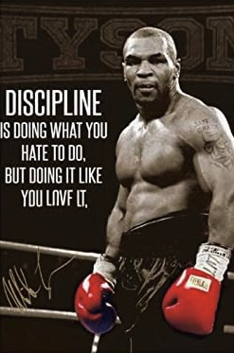
“Motivation gets you going. Discipline keeps you growing.”
— John C. Maxwell
Motivation vs. Discipline
Notes:
Motivation:
Motivation is the initial spark, the enthusiasm or desire that pushes you to start something. It can be a feeling of excitement, a need to achieve something, or the pressure to meet a deadline.
Discipline:
Discipline is the consistent effort and focus that keeps you going, even when you don't feel motivated. It's about sticking to your plan, resisting temptations, and making the necessary sacrifices to reach your goals.
Growth:
The quote highlights that discipline is crucial for sustained growth. Without consistent effort and self-control, even the most motivated efforts may not lead to lasting progress.

Slide 5
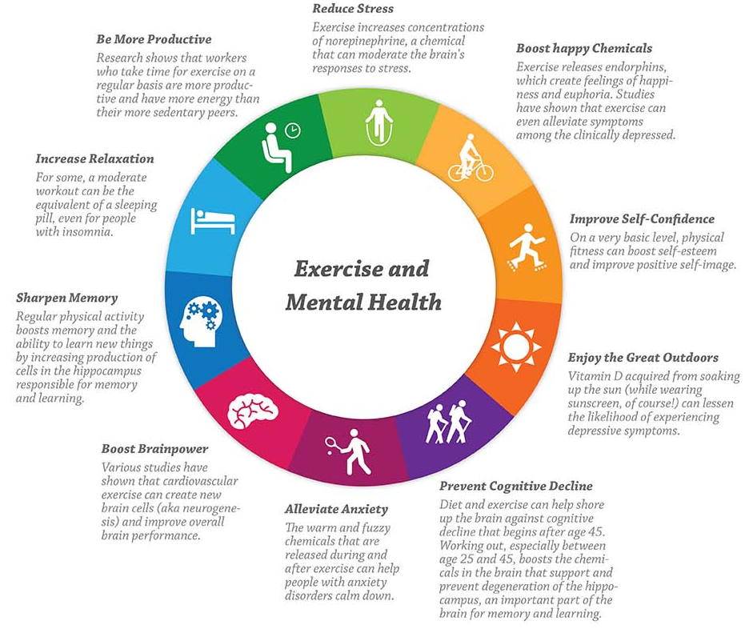
Exercise & Mental Health
Regular exercise reduces the risk of depression by 20–30%.
Exercise boosts endorphins and serotonin, improving mood and reducing anxiety.
*Source: Harvard Health, Mayo Clinic

Slide 6

Just 10 Minutes - Small actions → Big results.
Only 10 minutes of brisk activity can lift mental alertness and boost mood.
Notes:
Physical activity has a huge potential to enhance our well-being. Even a short burst of 10 minutes of brisk walking increases our mental alertness, energy and positive mood.
Participation in regular physical activity can increase our self-esteem and can reduce stress and anxiety. It also plays a role in preventing the development of mental health problems and in improving the quality of life of people experiencing mental health problems.
Mentalhealth.org

Slide 7
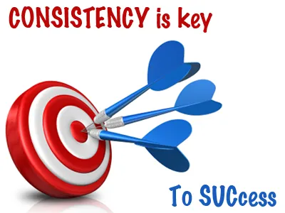
“Discipline is like a muscle — the more you train it, the stronger it gets.”
Discipline as a Skill
Notes:
The statement "Discipline is like a muscle — the more you train it, the stronger it gets" emphasizes the concept of self-discipline as a skill that can be cultivated and improved through consistent practice. Similar to physical muscles, the more you actively engage in disciplined behavior, the more resilient and effective your self-control becomes.
Here's a more detailed breakdown:
Metaphor:
The analogy of a muscle helps to visualize how discipline can be developed and strengthened through repeated effort.
Training:
Just like you train a muscle with exercise, you train discipline by consistently setting and achieving goals, making small changes, and resisting temptations, according to a post on LinkedIn.
Growth:
The more you practice discipline, the more effortlessly you will be able to manage your thoughts, emotions, and actions, says the American Psychological Association (APA).
Benefits:
A stronger sense of self-discipline leads to increased productivity, better goal achievement, and a greater sense of control over your life, according to a post on Reddit.

Slide 8

What’s Next?
Build your daily habits.
Move every day — even a little counts.
Choose discipline over motivation.
Join our 30-Day Movement Challenge.
Ask about my BASECAMP Accountability Coaching!

